Slide 1

Self
Development
Abde lali
Abde lali
belmqadem
belmqadem

Slide 2


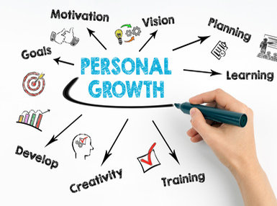
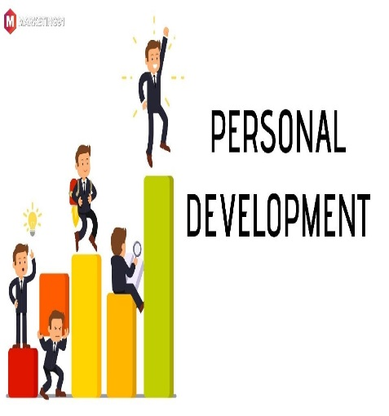

PLAN
Definition of self-development
Goals of self development
self-development Tools/technique
steps of personal development.
conclusion

Slide 3

Definition of self-development
Improve Skills
maximise potential
take charge of your actions
fulfilling life
satisfaction and success in life.

Slide 4



Goals of self development
Improve your time management.
Manage stress effectively

Slide 5




Goals of self development
Confidence
Forget the past
Improve your public speaking skills
Ignore your limitations

Slide 6


self-development Tools/technique
Know Yourself
Write every day
Start easy
Get Out of Your Comfort Zone
Give up Your Bad Habit

Slide 7
self-development Tools/technique
Keep Negative People outside
Goodbye to Excuses and Complaints
Learn How to Manage Your Emotions
Learn to Love Yourself
Believe in Yourself

Slide 8
steps of personal development
1
2
Set yourself goals.
Set yourself deadlines for when you want to achieve them.
Prioritise those goals
Recognise threats and opportunities.
3
4
Develop your skills or increase your knowledge
Look your progress
Use your support network

Slide 9


